Slide 1
Ideas From Deep Reinforcement Learning
Presenter: Kim Seung Hwan (overnap@khu.ac.kr)

Slide 2
Deep Reinforcement Learning
Reinforcement learning (RL) is an area of machine learning concerned with how intelligent agents ought to take actions in an environment in order to maximize the notion of cumulative reward (Wikipedia definition)
I took a reinforcement learning class last semester
A few ideas that were borrowed into the CV field caught my eyes

Slide 3
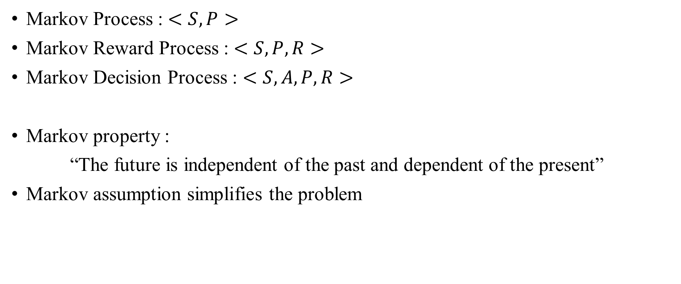
Deep Reinforcement Learning
Markov Process : $<S,P>$
Markov Reward Process : $<S,P,R>$
Markov Decision Process : $<S,A,P,R>$
Markov property :
“The future is independent of the past and dependent of the present”
Markov assumption simplifies the problem

Slide 4
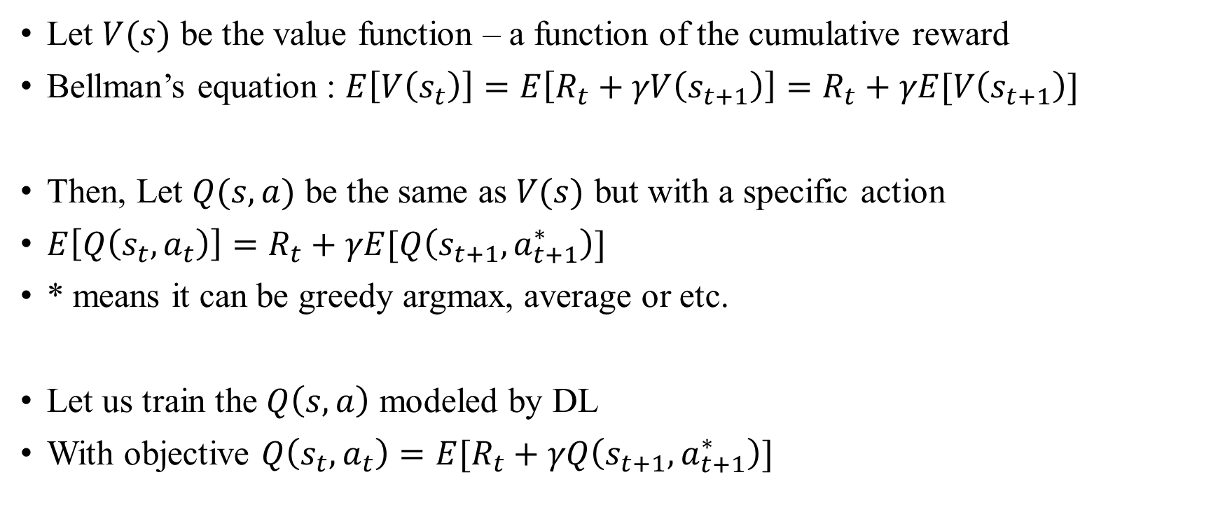
Deep Reinforcement Learning
Let $V(s)$ be the value function – a function of the cumulative reward
Bellman’s equation : $E\left[V\left(s_{t}\right)\right]=E\left[R_{t}+γV\left(s_{t+1}\right)\right]=R_{t}+γE[V\left(s_{t+1}\right)]$
Then, Let $Q(s,a)$ be the same as $V(s)$ but with a specific action
$E\left[Q\left(s_{t},a_{t}\right)\right]=R_{t}+γE[Q\left(s_{t+1},a_{t+1}^{∗}\right)]$
* means it can be greedy argmax, average or etc.
Let us train the $Q\left(s,a\right)$ modeled by DL
With objective $Q\left(s_{t},a_{t}\right)=E[R_{t}+γQ\left(s_{t+1},a_{t+1}^{∗}\right)]$

Slide 5
Deep Reinforcement Learning
The model takes itself as the learning target
It means that the object to be learned is moving
This is called non-stationary problem, etc.
It creates strong variance, like the mini-batch SGD
We should manage the variance, just as we did with batch normalization for SGD
Deep Q-Learning (DQN)

Slide 6
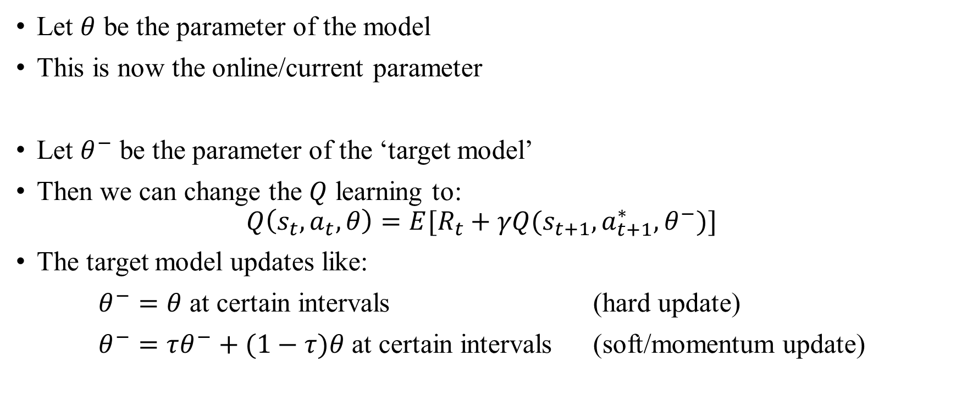
Deep Reinforcement Learning
Let $θ$ be the parameter of the model
This is now the online/current parameter
Let $θ^{−}$ be the parameter of the ‘target model’
Then we can change the $Q$ learning to:
$$Q\left(s_{t},a_{t},θ\right)=E[R_{t}+γQ(s_{t+1},a_{t+1}^{∗},θ^{−})]$$
The target model updates like:
$θ^{−}=θ$ at certain intervals (hard update)
$θ^{−}=τθ^{−}+(1−τ)θ$ at certain intervals (soft/momentum update)

Slide 7
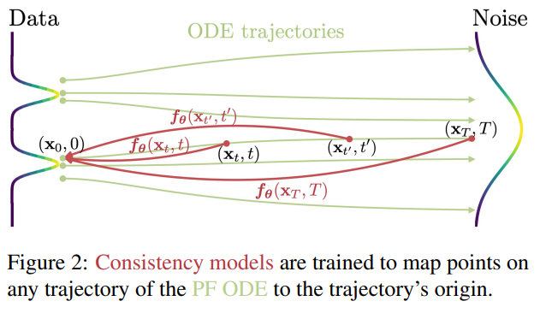
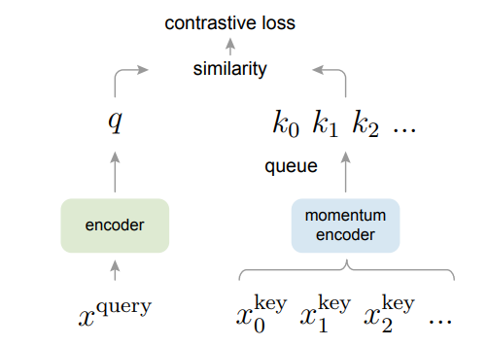
Contrastive Learning
Momentum Contrast (MoCo)
Bootstrap Your Own Latent (BYOL)
Consistency Model

Slide 8
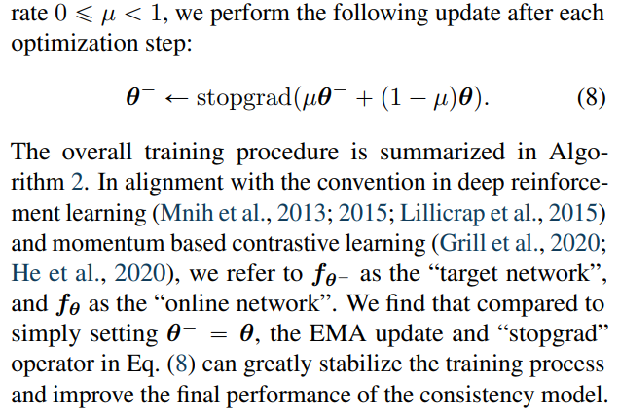
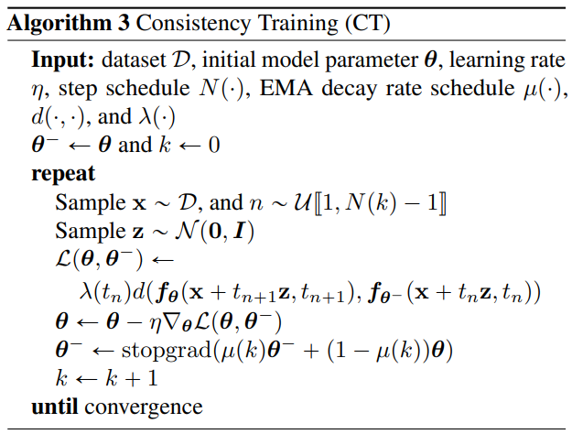
Contrastive Learning

Slide 9
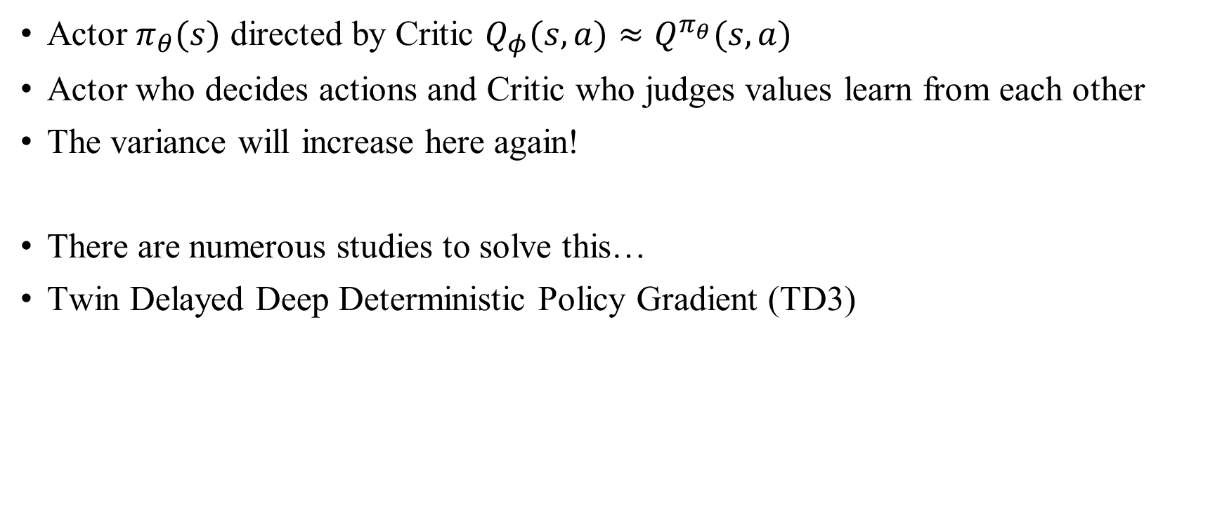
Actor Critic
Actor $π_{θ}(s)$ directed by Critic $Q_{φ}(s,a)≈Q^{π_{θ}}(s,a)$
Actor who decides actions and Critic who judges values learn from each other
The variance will increase here again!
There are numerous studies to solve this…
Twin Delayed Deep Deterministic Policy Gradient (TD3)

Slide 10
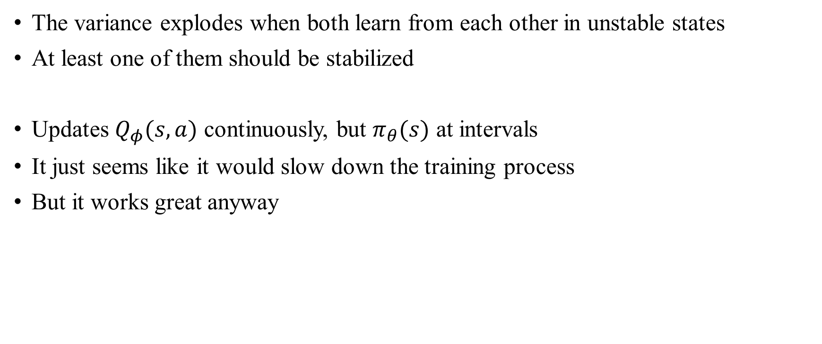
Actor Critic
The variance explodes when both learn from each other in unstable states
At least one of them should be stabilized
Updates $Q_{φ}(s,a)$ continuously, but $π_{θ}(s)$ at intervals
It just seems like it would slow down the training process
But it works great anyway

Slide 11
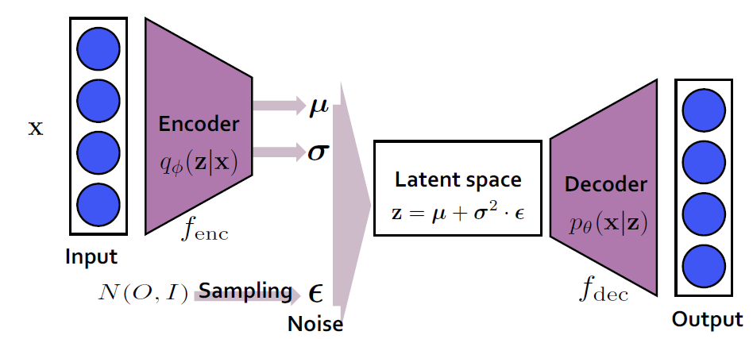
Training Dynamics
Complex models for high-level tasks
Generation models e.g. VAE, GAN

Slide 12
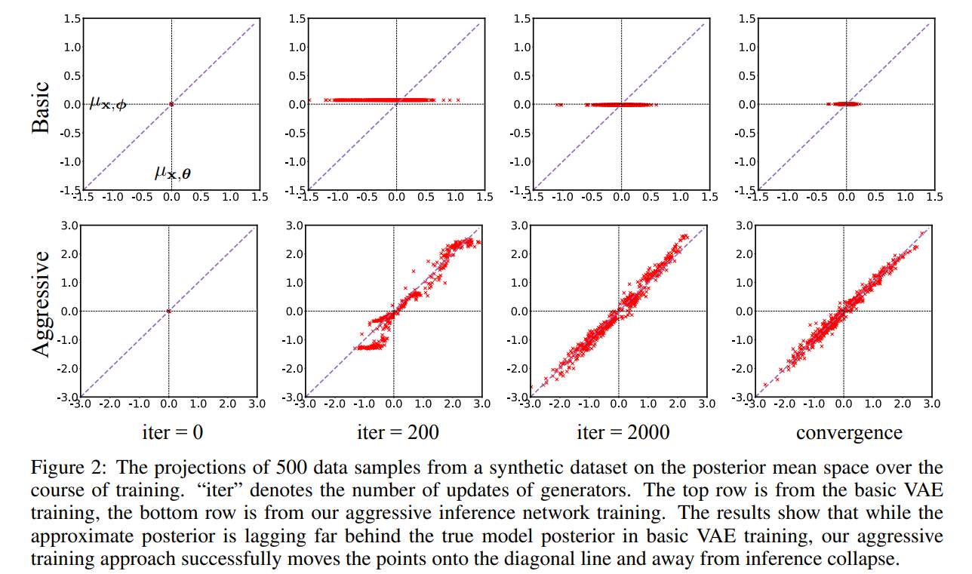
Training Dynamics
Lagging Inference Networks And Posterior Collapse In Variational Autoencoders

Slide 13
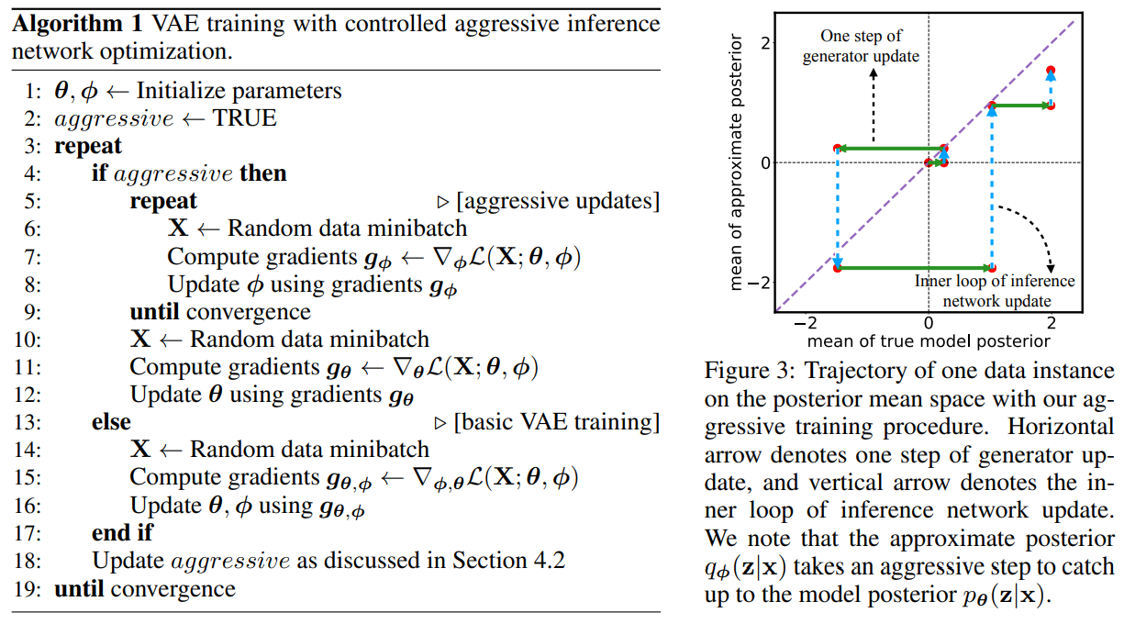
Training Dynamics
Lagging Inference Networks And Posterior Collapse In Variational Autoencoders

Slide 14
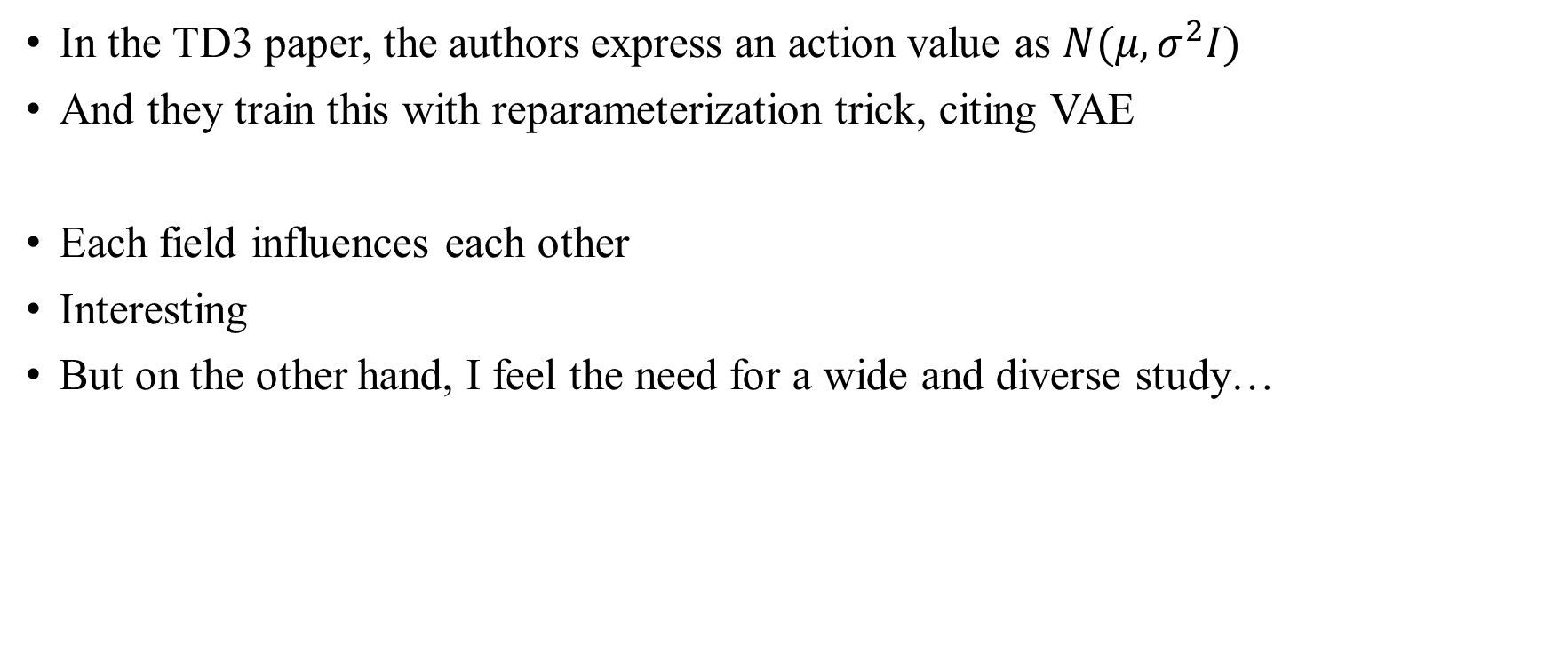
Actor Critic
In the TD3 paper, the authors express an action value as $N(μ,σ^{2}I)$
And they train this with reparameterization trick, citing VAE
Each field influences each other
Interesting
But on the other hand, I feel the need for a wide and diverse study…

Slide 15
Thank you for listening
Presenter: Kim Seung Hwan (overnap@khu.ac.kr)

